Slide 1

FINAL YEAR RESEARCH PROJECT
End-Term Presentation
Multimodal Depression detection using speech and linguistic behaviour analysis across conversational phases
Supervised By: Ms. Ruby
Group No.: 33-14
DEBI PRASAD NANDA (2241014018)
DEBASISH NANDA (2241014017)
CHANDNA NAYAK (2241014072)
PUSHPAJA PRIYADARSHINI (2241016474)
PRABYASACHI MOHANTY (2241013258)
Department of Computer Sc. and Engineering
Faculty of Engineering & Technology (ITER)
Siksha ‘O’ Anusandhan (Deemed to be) University
Bhubaneswar, Odisha
1

Slide 2
Presentation Outline
Problem Statement & Motivations
Problem Statement
Motivations
Literature Review
Existing Solutions & Limitations
Proposed Methodology & Approach
Key Components/Modules & Algorithms Used
Dataset(s) & Tools/Technologies
Experimentation
System Specification
Experimental Results
Performance Analysis
Conclusion and Future Scope
References
2

Slide 3
Problem Statement
Depression is a serious and widespread mental health disorder that often remains undiagnosed or untreated.
Traditional diagnosis relies on clinical assessments, which are time-consuming, subjective, and require expert intervention.
There is a growing need for automated and scalable systems that can detect depression early by analyzing behavioral signals such as speech patterns and linguistic expressions.
3

Slide 4
Motivations
Early detection of depression can help prevent severe psychological and social consequences
Speech and language patterns provide valuable insights into an individual’s mental state
The availability of conversational datasets enables large-scale automated analysis
AI-based systems can assist clinicians by providing objective and scalable mental health assessment tools
4

Slide 5
Literature Review
Table 1:Summary of Existing Approaches and Research Limitations
S. No. | Author & Year | Methods/Techniques Used | Dataset Used | Research Outcomes | Findings
1 | Gong & Poellabauer (2017) | Feature Extraction: Topic Modeling (context-aware segmentation)Classification: Multimodal feature vector + feature selection | DAIC-WOZ dataset | Improved performance over baseline methods | Captures temporal/contextual details effectively; limited by small sample size and feature dimensionality issues
2 | Park & Moon (2022) | Feature Extraction: BERT-CNN (text), CNN-BiLSTM (audio)Classification: Attention-based multimodal fusion | DAIC-WOZ dataset | Improved accuracy over single-modal models | Attention-based fusion improves accuracy; still dependent on quality of preprocessing and multimodal alignment
3 | Guo et al. (2022) | Feature Extraction: Transformer-based (RoBERTa, wav2vec 2.0) with Topic Attention Classification: Two-branch multimodal transformer with late fusion | DAIC-WOZ dataset | Accuracy: 90%+ (reported improvement) Recall: Improved via attention | Effective use of topic-level attention improves detection; handles data scarcity using pre-trained models but still limited by small dataset size
5

Slide 6
Literature Review
S. No. | Author & Year | Methods/Techniques Used | Dataset Used | Research Outcomes | Findings
4 | Yoo & Oh (2023) | Feature Extraction: CNN (audio), Transformer (text)Classification: Tensor Fusion Network + LSTM | DAIC-WOZ dataset | Moderate improvement (no exact metrics provided) | Fusion of text and voice improves detection; lacks detailed quantitative evaluation and scalability analysis
5 | Nykoniuk et al. (2025) | Feature Extraction: CNN + Bi-LSTM + Self-Attention Classification: Early and Late Fusion models | DAIC-WOZ, EDAIC-WOZ datasets | Accuracy: 86% F1 Score: 0.79 | Early fusion performs better; multimodal improves accuracy but dataset imbalance affects reliability
6 | Xu et al. (2025) | Feature Extraction: BERT (text), wav2vec 2.0 (audio)Classification: Bi-LSTM + multi-scale convolution + adaptive pooling | CMDC & DAIC-WOZ datasets | F1 Score: Improved significantly RMSE reduced | Strong cross-modal feature integration; handles multiple datasets but requires large training data and complex architecture
7 | Gan et al. (2025) | Feature Extraction: LLM (LLaMA), Audio processing Classification: Teacher–Student multimodal fusion with attention | DAIC-WOZ dataset | F1 Score: 0.991 | Very high accuracy using teacher-student architecture; strong multimodal fusion but computationally complex and data-dependent
6

Slide 7
Research Gap & Improvements
Most existing approaches treat the entire interview as a single unit for analysis
This global representation fails to capture temporal variations in speech and behavioral patterns
Important changes in emotional state, hesitation, and response patterns across different stages of the conversation are overlooked
As a result, subtle indicators of depression that emerge gradually may not be effectively detected
Proposed Improvement:
The proposed system analyzes depression across three conversational phases i.e. beginning, middle, and end of the interview.
For each phase, the model generates a depression probability score based on both audio and linguistic features.
These phase-wise scores are then compared to identify in which phase depression indicators are most prominent.
This allows us to understand how depressive behavior evolves during the conversation and determine the phase where depression is most clearly detectable.
“We are not just predicting depression,
we are analyzing how depression signals change across different phases of the conversation.”
7

Slide 8
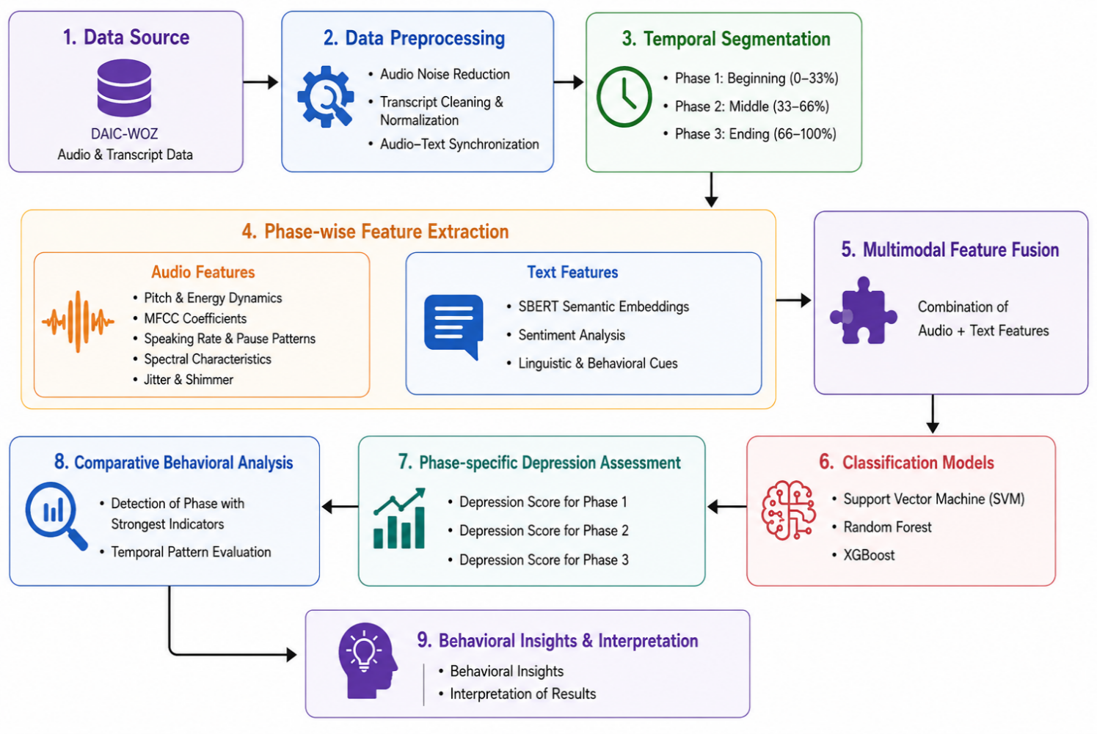
Proposed Solution & Architecture
Fig. 2: Schematic Model Diagram of the Proposed Model
8

Slide 9
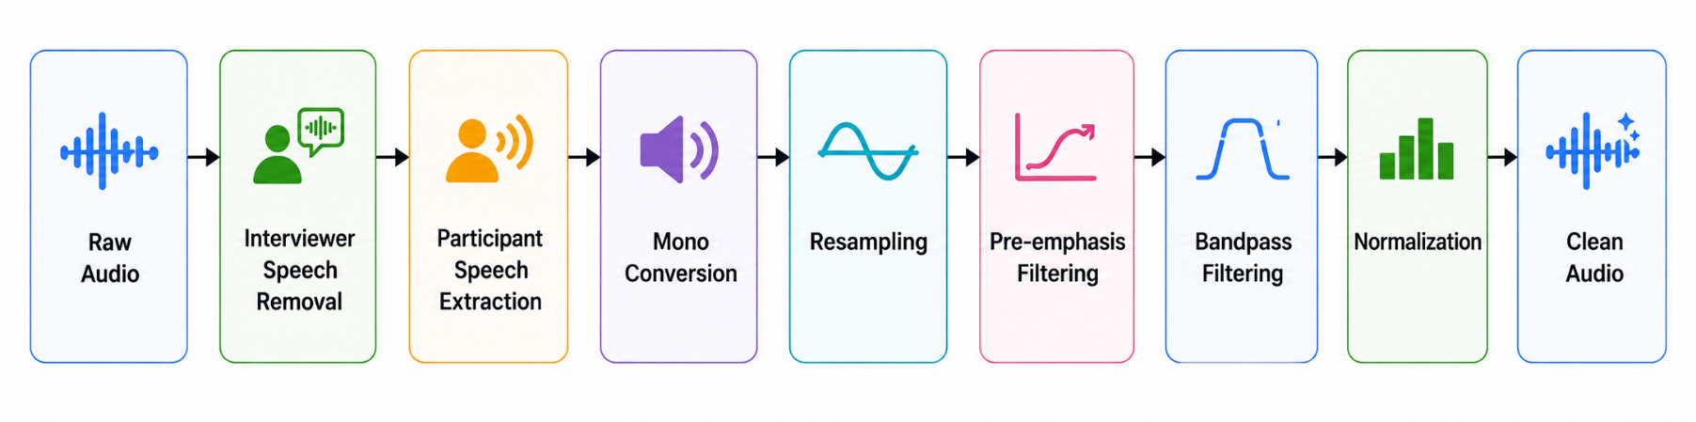
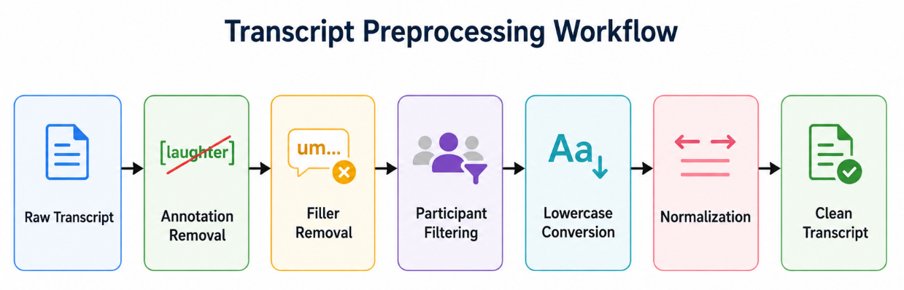
Proposed Solution & Architecture cont.
Figure 3. Audio preprocessing pipeline from raw WAV to cleaned participant waveform.
Figure 4. Audio preprocessing pipeline from raw WAV to cleaned participant waveform.

Slide 10
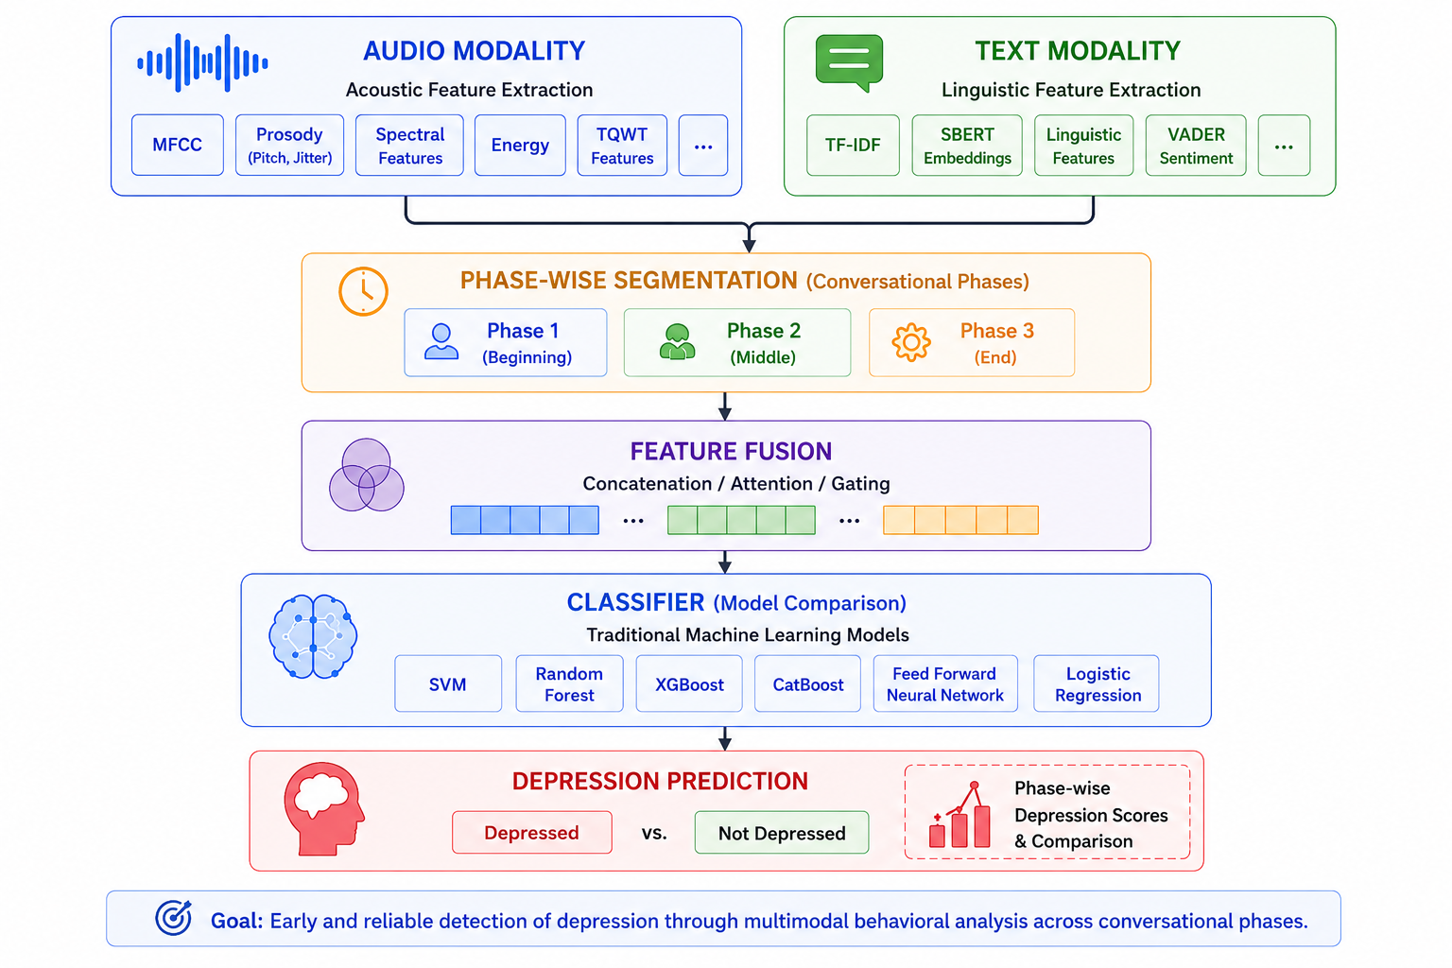
Proposed Solution & Architecture cont.
Figure 4. Multimodal Architecture For Depression Detection.

Slide 11
Proposed Solution & Architecture cont.
The proposed system performs multimodal depression detection by analyzing both speech and linguistic behavioural information obtained from conversational clinical interviews. Instead of treating the complete interview as a single unit, the framework performs phase-wise conversational analysis to study how depression-related behavioural patterns evolve across different stages of interaction.
Initially, multimodal conversational data consisting of participant audio recordings, conversational transcripts, and depression labels are obtained from the DAIC-WOZ dataset. Both audio and textual modalities undergo preprocessing to remove irrelevant information and retain only participant-specific behavioural content.
For audio preprocessing, interviewer speech is removed, participant speech segments are extracted, and multiple signal enhancement operations such as resampling, filtering, and normalization are applied to improve acoustic consistency. Similarly, transcript preprocessing involves annotation removal, filler-word elimination, participant filtering, lowercase conversion, and text normalization to obtain clean linguistic data suitable for analysis.
11

Slide 12
Proposed Solution & Architecture cont.
After preprocessing, the complete interview is divided into three conversational phases:
Beginning Phase
Middle Phase
Ending Phase
This phase-wise segmentation enables temporal behavioural analysis by examining how emotional and conversational characteristics vary throughout the interview.
Feature extraction is then performed separately for both modalities across each conversational phase. From the audio modality, behavioural acoustic features such as MFCC, pitch, prosodic characteristics, spectral features, energy dynamics, pause patterns, and TQWT-based representations are extracted. From the textual modality, semantic and linguistic features including SBERT embeddings, sentiment information, and behavioural linguistic cues are obtained.

Slide 13
The extracted audio and textual representations are combined using multimodal feature fusion to generate richer behavioural feature representations. These fused multimodal features are then provided to multiple machine learning classifiers including Support Vector Machine (SVM), Random Forest, XGBoost, CatBoost, Feed Forward Neural Network (FNN), and Logistic Regression for comparative depression classification.
The system generates depression predictions separately for each conversational phase, allowing comparative phase-wise behavioural assessment. This helps identify which conversational stage contains the strongest depression-related indicators and provides deeper understanding of temporal behavioural evolution during clinical interaction.
Finally, the framework performs behavioural interpretation and comparative analysis based on phase-wise multimodal predictions to determine whether the participant is depressed or non-depressed while also analyzing how depression-related behavioural signals vary across conversational phases.

Slide 14
Dataset & Tools/Technologies
Dataset Used — DAIC-WOZ
Multimodal clinical interview dataset designed for psychological distress analysis
Contains participant audio recordings, conversational transcripts, and PHQ-based depression labels
Provides participant–interviewer interactions suitable for behavioural and emotional analysis
Used to study depression-related acoustic and linguistic behavioural patterns across conversational phases
Audio Processing & Feature Extraction
Librosa — MFCC, spectral, chroma, and acoustic feature extraction
Parselmouth (Praat) — pitch, pauses, and speech behavioural analysis
TQWT-based analysis for non-stationary emotional speech representation
Text & Linguistic Analysis
Sentence-BERT (SBERT) — semantic text embeddings
VADER Sentiment Analysis — sentiment and emotional polarity extraction
Transcript preprocessing and linguistic behavioural analysis
14

Slide 15
Machine Learning & Experimentation
Scikit-learn — SVM, Random Forest, Logistic Regression
XGBoost & CatBoost — ensemble-based depression classification
Pandas & NumPy — preprocessing, feature handling, and dataset management
Development Environment
Python 3.12
Jupyter Notebook
Matplotlib & Seaborn for visualization and comparative analysis

Slide 16
Experimentation
System Specifications:
Hardware Specifications:
Software Specifications:
Component | Specification
Processor | Intel Core i7-12650H (12th Gen)
RAM | 16 GB
GPU | NVIDIA GeForce RTX 3050 (4GB)
Operating System | Windows 11 Home
System Type | 64-bit Operating System
Software / Tool | Purpose
Python 3.12 | Core implementation
Jupyter Notebook | Experimentation environment
Librosa | Audio feature extraction
Parselmouth | Speech signal analysis
Sentence-BERT (SBERT) | Semantic text embeddings
Scikit-learn | Machine learning models
Pandas & NumPy | Data handling and preprocessing
Matplotlib & Seaborn | Visualization and plotting
16

Slide 17
Experimental Analysis:
The experimental results clearly demonstrate that the multimodal approach consistently achieved better classification performance compared to text-only and audio-only models across all conversational phases.
By combining both audio and linguistic information, the multimodal framework was able to capture complementary behavioral patterns associated with depression more effectively.
The text-only models primarily captured semantic and emotional information from participant transcripts, while the audio-only models focused on acoustic characteristics such as pitch, pauses, energy variation, and speaking rate. However, each individual modality contained limited behavioral information when used independently.
In contrast, the multimodal framework integrated both vocal and linguistic cues, allowing the classifiers to learn richer and more discriminative behavioral representations.
This fusion significantly improved model robustness, classification stability, and overall prediction capability. Among all conversational phases, Phase 1 consistently achieved the highest accuracy across most models in the multimodal experiments.
This indicates that the beginning stage of the interview contains stronger and more distinguishable depression-related cues.
17

Slide 18
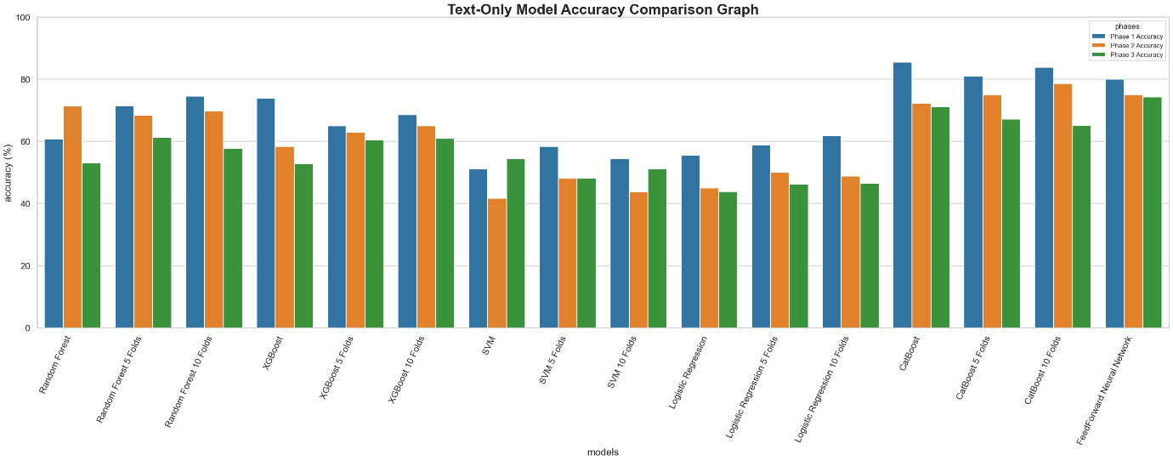
18

Slide 19
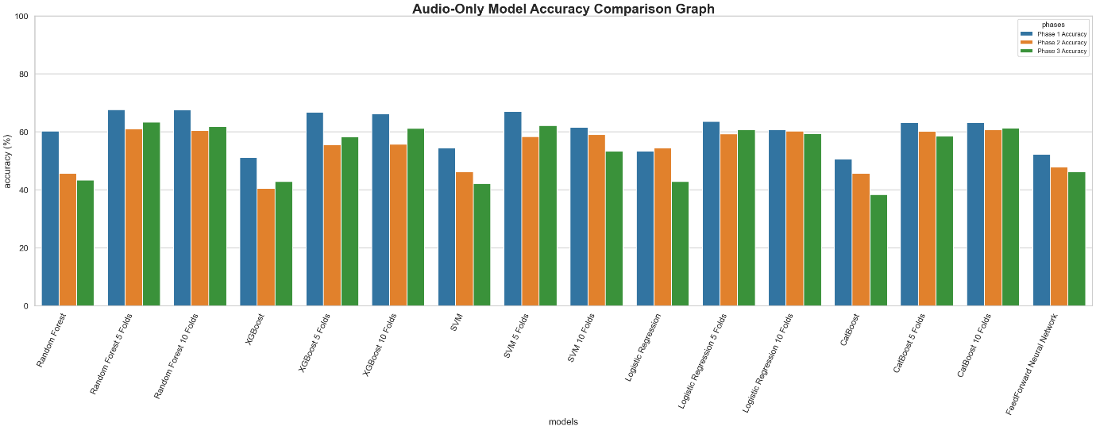
19

Slide 20
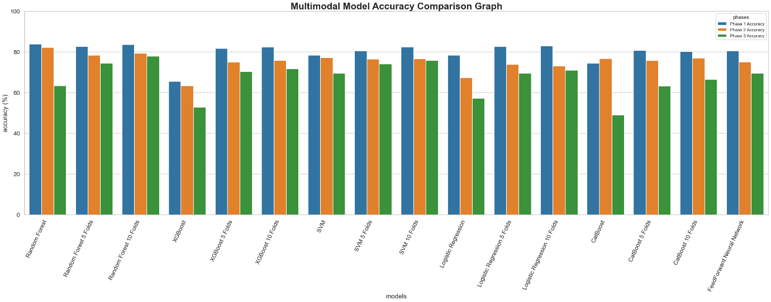
20

Slide 21
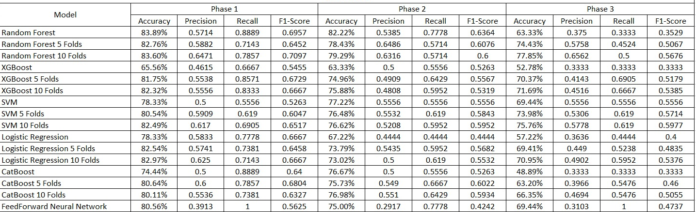
Comparative Performance Analysis of Multimodal Models:
The proposed multimodal framework was evaluated using multiple machine learning models across three conversational phases of the DAIC-WOZ interviews. Performance was measured using Accuracy, Precision, Recall, and F1-score.
Among all models, the Random Forest classifier achieved the best overall performance in Phase 1 with an accuracy of 83.89% and recall of 0.8889, indicating strong depression detection capability during the initial conversational stage.
Phase-wise Multimodal Model Performance Comparison
21

Slide 22
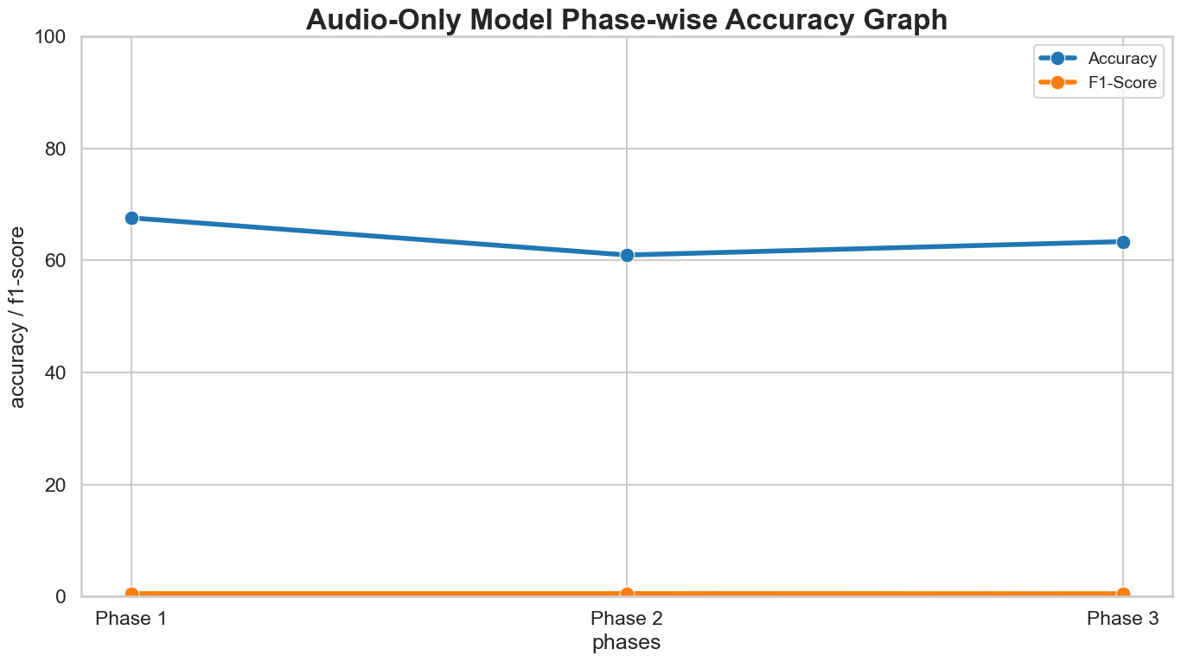
Phase-Wise Depression Analysis:
22

Slide 23
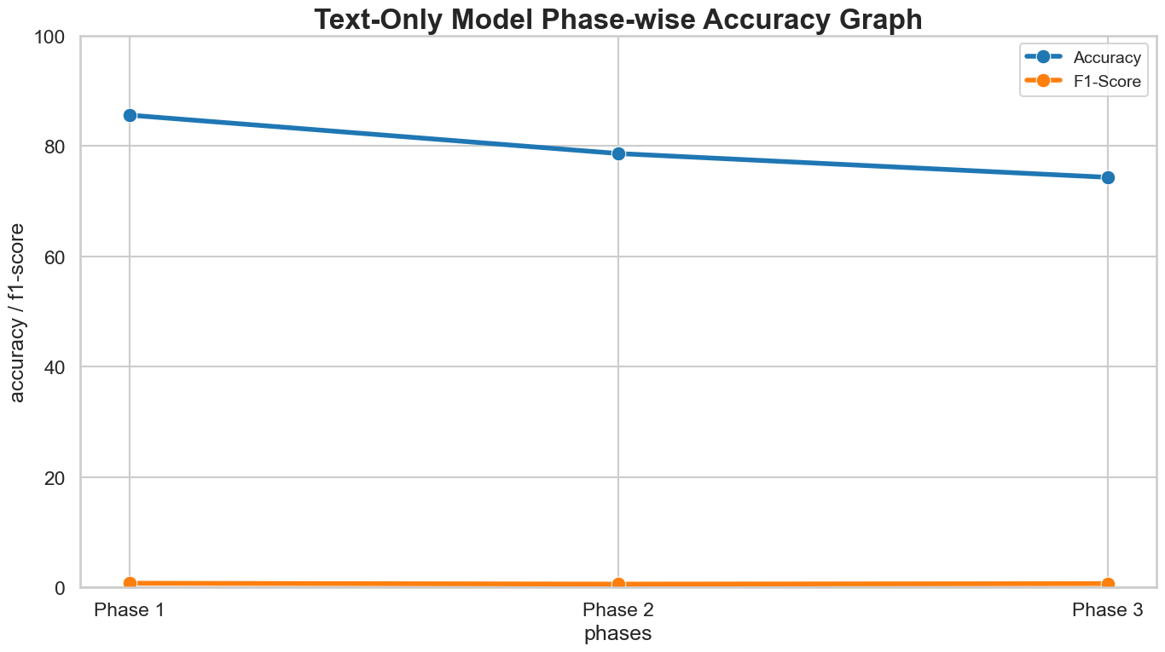
23

Slide 24
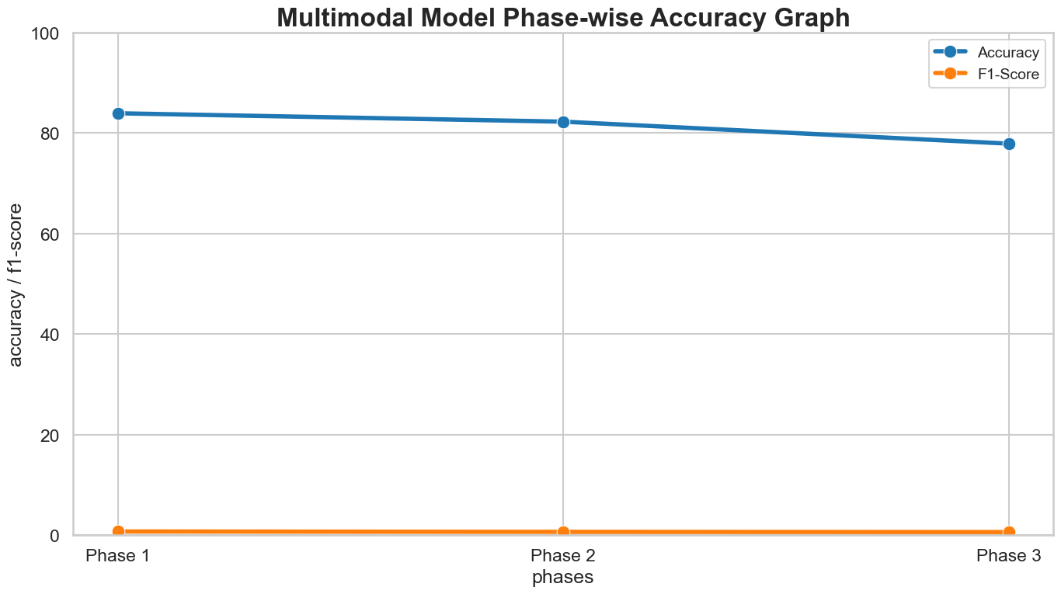
24

Slide 25
The phase-wise experimental results show that Phase 1 consistently achieved the highest classification accuracy across all three approaches.
In the text-only framework, Phase 1 produced the strongest performance, indicating that early conversational language patterns contain significant semantic and emotional indicators of depression.
Similarly, the audio-only framework achieved better performance during the beginning stage, suggesting that initial vocal behavior contains distinguishable acoustic cues such as hesitation, reduced confidence, abnormal pauses, and lower vocal variability.
The multimodal framework achieved the best overall performance among all approaches by combining audio and textual behavioural information.
The multimodal model maintained consistently higher accuracy across all phases demonstrating that integrating complementary modalities improves classifications robustness and behavioural understanding.
25

Slide 26
Performance Analysis:
The ROC-AUC curves and confusion matrix analyses presented in this study were generated using the proposed multimodal Random Forest classification model.
The model was trained using fused audio and linguistic features extracted from different conversational phases of the DAIC-WOZ interviews.
Audio-based behavioral cues such as MFCC, pitch, pauses, and spectral characteristics were combined with text-based semantic and sentiment features to form a unified multimodal feature representation.
The Random Forest classifier was then evaluated separately on the beginning, middle, and ending conversational phases to analyze how depression-related behavioral patterns vary across different stages of interaction.
26

Slide 27
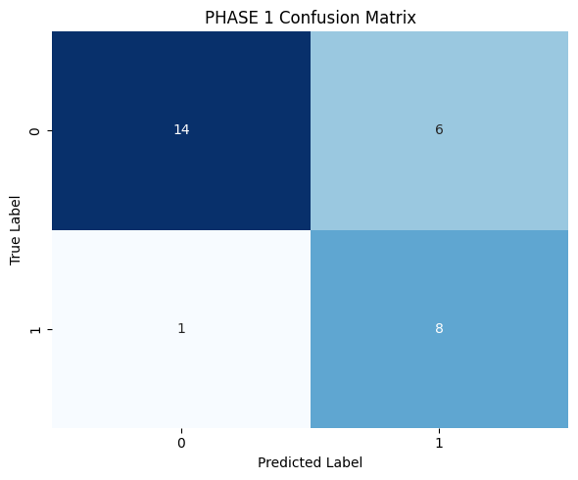
Phase 1 Analysis :
Phase 1 achieved the best overall performance among all conversational stages. The model successfully identified most depressed participants with only one false negative, indicating strong sensitivity toward depression-related behavioural cues during the initial interaction stage.
This suggests that early conversational behaviour may contain strong indicators such as:
hesitation
reduced confidence
constrained emotional expression
abnormal speech characteristics
which help improve classification performance.
27

Slide 28
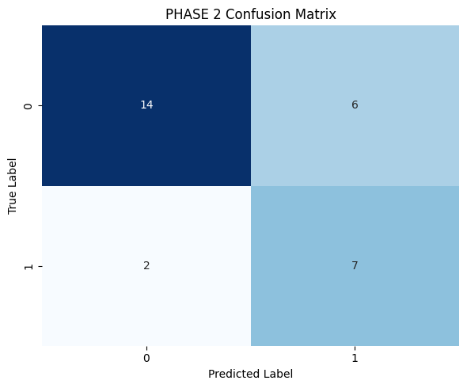
Phase 2 Analysis :
Phase 2 maintained relatively stable classification performance but showed a slight reduction in depression detection capability compared to Phase 1. The increase in false negatives suggests that some depression-related behavioral patterns became less distinguishable during the middle stage of the conversation.
28

Slide 29
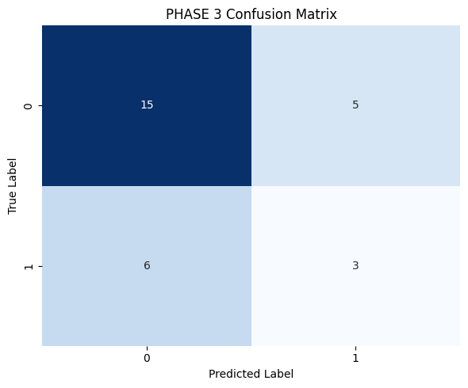
Phase 3 Analysis :
Phase 3 achieved the weakest depression classification performance. Although the model correctly identified most non-depressed participants, it failed to detect several depressed participants, resulting in a higher number of false negatives.
This indicates that depression-related acoustic and linguistic cues became less discriminative during the later stage of the interview.
Possible reasons include:
conversational adaptation
emotional stabilization
reduced behavioural variability
conversational fatigue
29

Slide 30
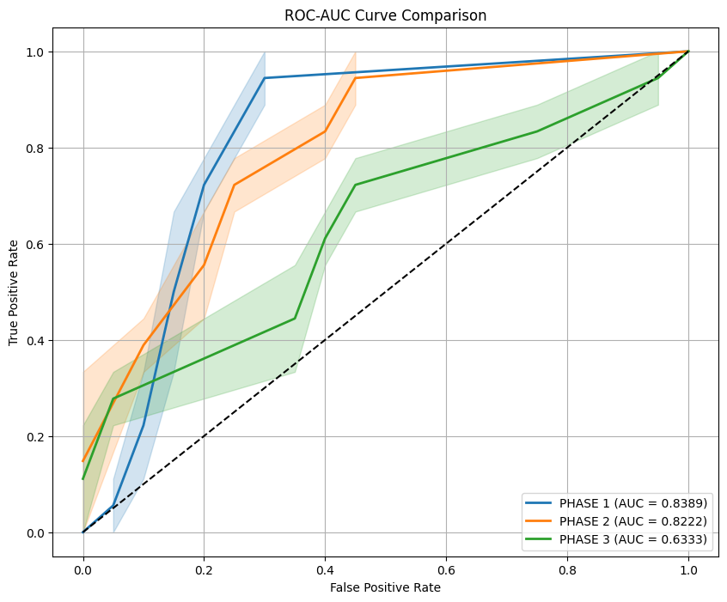
30

Slide 31
The experimental results show that:
Phase 1 achieved the highest AUC score of 0.8389, indicating superior classification capability during the initial conversational stage.
Phase 2 obtained an AUC of 0.8222, showing comparatively strong but slightly lower performance.
Phase 3 produced the lowest AUC value of 0.6333, suggesting weaker discriminative behavioural patterns during later stages of the conversation.
These findings indicate that depression-related acoustic and linguistic cues were more prominent and distinguishable during the beginning phase of the interview. Initial conversational behaviour such as hesitation, reduced confidence, abnormal pauses, and constrained emotional expression may have contributed to stronger classification performance in Phase 1.
Overall, the ROC analysis validates the effectiveness of phase-wise conversational analysis and demonstrates that early-stage interaction contains significant depression-related behavioural information.
31

Slide 32
Conclusion and Future Scope
Conclusion:
A multimodal depression detection framework using speech and linguistic behavior analysis was proposed.
The interview was divided into beginning, middle, and ending conversational phases to analyze temporal behavioral variations.
Audio features and textual semantic features were extracted and combined using multimodal fusion.
Machine learning models such as SVM, Random Forest, and XGBoost were evaluated for depression classification.
Experimental results showed that multimodal analysis improved classification performance. Phase 1 achieved the highest accuracy, indicating stronger depression-related cues during the initial stage of conversation.
The proposed framework effectively captured behavioral patterns associated with depression.
32

Slide 33
Conclusion and Future Scope
Future Scope:
Integration of advanced deep learning models such as BiLSTM and Transformers.
Development of real-time depression monitoring systems.
Inclusion of additional modalities such as facial expressions and physiological signals.
Extension to multilingual and cross-cultural datasets.
Deployment as a clinical decision-support system for mental health applications.
33

Slide 34
References
[1] Y. Guo, C. Zhu, S. Hao, and R. Hong, “A topic-attentive transformer-based model for multimodal depression detection,” arXiv preprint arXiv:2206.13256, 2022.
[2] L. Gan, Y. Huang, X. Gao, J. Tan, F. Zhao, and T. Yang, “Multimodal magic: Elevating depression detection with a fusion of text and audio intelligence,” Preprint, 2025.
[3] Y. Gong and C. Poellabauer, “Topic modeling based multi-modal depression detection,” in Proc. 7th Annu. Workshop Audio/Visual Emotion Challenge (AVEC ’17), ACM Multimedia, 2017.
[4] M. Nykoniuk, O. Basystiuk, N. Shakhovska, and N. Melnykova, “Multimodal data fusion for depression detection approach,” Computation, vol. 13, no. 1, p. 9, 2025.
[5] H. Yoo and H. Oh, “Depression detection model using multimodal deep learning,” Preprints, 2023.
[6] Z. Xu, Y. Gao, F. Wang, L. Zhang, L. Zhang, J. Wang, and J. Shu, “Depression detection methods based on multimodal fusion of voice and text,” Scientific Reports, vol. 15, p. 21907, 2025.
[7] J. Park and N. Moon, “Design and implementation of attention depression detection model based on multimodal analysis,” Sustainability, vol. 14, no. 6, p. 3569, 2022.
34

Slide 35

35

